Slide 1
University of Texas
Travel Management Services

Slide 2
CTP & ATI
Corporate Travel Planners, Inc.
Hours of Operation:
8:00 AM – 6:00 PM CST, M-F
Toll-Free: (866) 366-1142
Phone: (210) 366-9565
Fax: (888) 605-6555
Email: UTSW@ctp-travel.com
Online Help Desk: (877) 727 5188
After Hours Emergency (800) 441-6512 VIT Code S2P2A
www.ut-ctp.com
Anthony Travel, Inc.
Hours of Operation:
8:00 AM – 6:00 PM CST, M-F
Toll-Free: (800) 684-2044
Phone: (512) 617-8444
Fax: (866) 921-6242
Email: UTSW@anthonytravel.com
After Hours Emergency (800) 342-9008 VIT Code S4RRG
utsystem.anthonytravel.com

Slide 3
Services Offered
Dedicated Travel Consultants
Experienced International Agents
Unused Ticket Management
After-Hours Support
Passports & Visas
Online Booking Including Web Fares

Slide 4
Traveler Profiles
Go To: www.concursolutions.com
Sign In:
User Name = Email Address
Password = Welcome
Must change password after logging-in
Go to Profile and update your personal information

Slide 5
Invoice Delivery
E-Confirmations
VirtuallyThere Portal
Calendar Import
Online Check-In
Weather
Local Maps

Slide 6
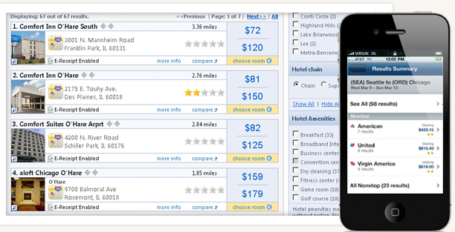
Concur
Concur is an online booking tool where travelers can book domestic/international flights, reserve rental cars and make hotel/rail reservations 24 hours a day, 7 days a week – all from their desktop browsers or smart phones
Integrated corporate, published and internet air and hotel fares in a single screen

